Slide 1
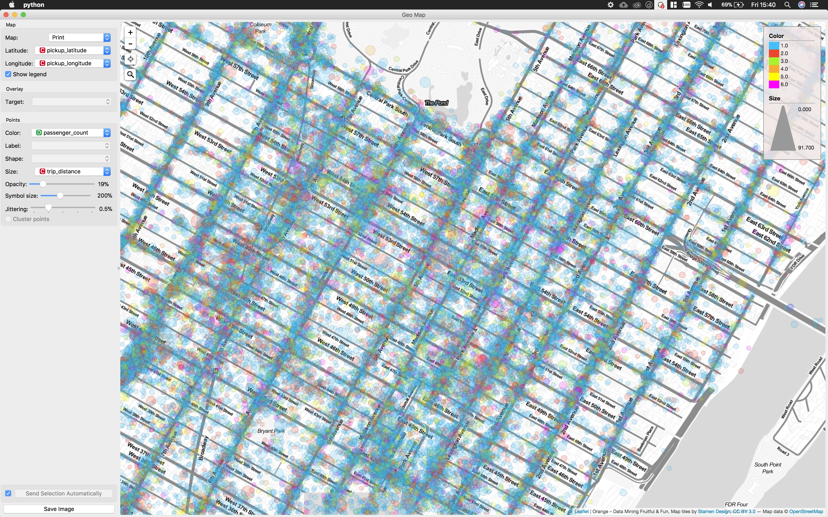
Team Newbie

Slide 2
Simple Ride Sharing
Motivations
Research has shown that up to 95% of New York taxi trips could be shared_{[1]}.
Detailed graph based model minimizing increased cost.
Reduced travel cost for customers
Reduces pollution and congestion
Increased profitability for drivers as less time spent idle between journeys.
Goals
Develop simple algorithm to identify shareable rides
Create an algorithm that creates shared rides based on the two trip sharing case from Santi’s “Quantifying the benefits of vehicle pooling with share ability networks”
Visualize the shared rides in browser to allow fast analysis of algorithm effectiveness

Slide 3
Data Cleaning
Remove taxi journeys where the car is full (Passengers > 3)
Remove data not relevant to ride sharing
E.g. Medallion Number, Hack License
Remove jobs with latitudes/longitudes outside of NY bounding box
Use of anomalous/invalid locations (such as data points in the ocean) was avoided due to rejecting one sized clusters, as well as the requirement for small distances between shared ride pickup and drop-off locations.

Slide 4
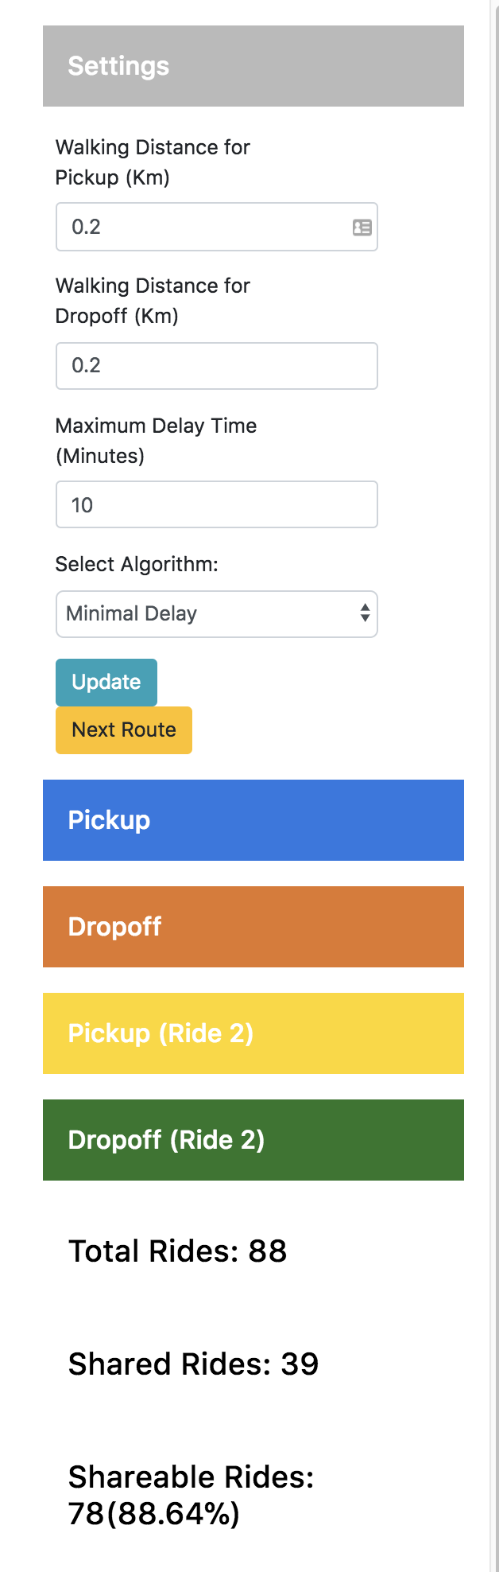
Simple HTTP API for Algorithm Constraints
Allows modification of parameters for rapid visualization
Maximum walking distance to pickup and drop-off
Maximum delay for drop off time.
Simple metrics of algorithm performance
More complex metrics would be useful here, such as average cost, journey length, etc.

Slide 5
Initial Naive Algorithm
Developed to test visualization
Groups rides that have tolerable pickup and drop-off times and locations
Creates a distance matrix between the pickup locations and drop-off locations for all rides.
Where two rides are acceptable in terms of distance between pickup and drop-off, ensure that they have similar drop-off times.
Collapse the sharable rides into single rides provided taxi has enough remaining seats

Slide 6
Assumptions
Taxis can accommodate at most four passengers
Taxi journeys with > 3 passengers are removed
Assume arrival time of journey is the time passengers wanted to arrive at destination
Pickup time is less important than arrival time, if journey times are similar and arrival time is maintained

Slide 7
Naive Algorithm - Results
Very low amount of shareable rides with ‘reasonable’ parameters.
10 minute delays, 200m walk to pickup/drop-off
Number of shareable rides out of total rides increases as walking distance to pickup and drop-off increases as expected

Slide 8
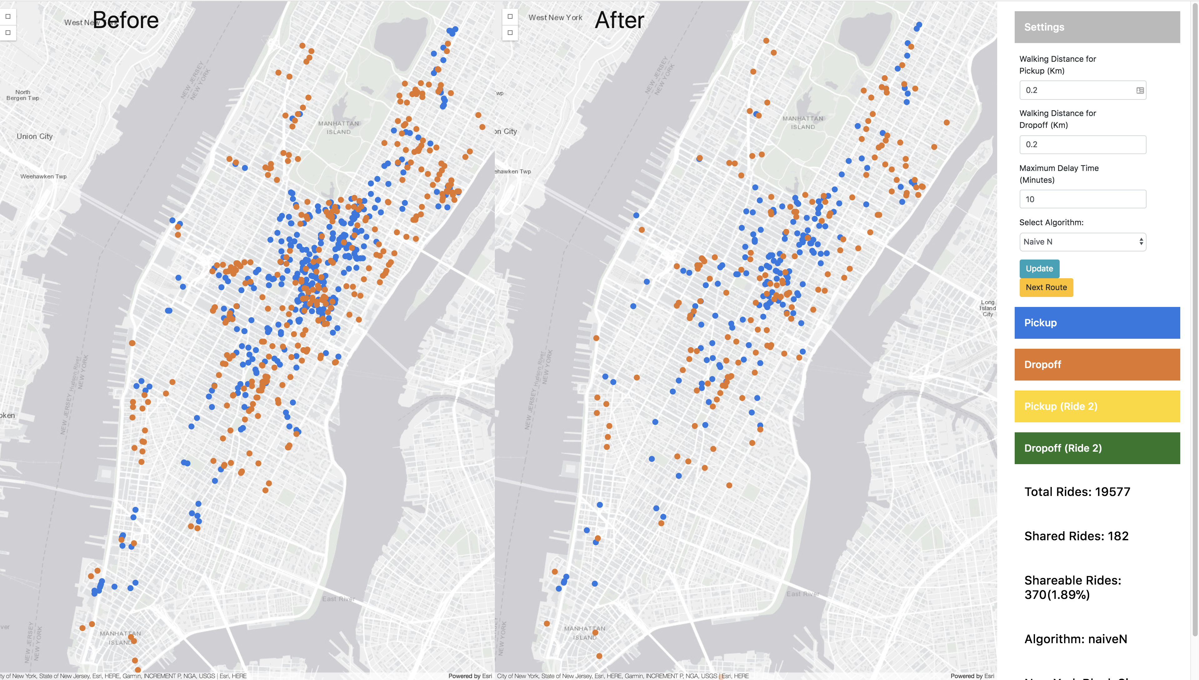

Slide 9
Minimal Delay Algorithm
Situation: “Booking could be offered cheaper fare during ride if they accept a delay”, or could book a ride knowing they may end up sharing.
Assumes a ride booking platform without prebookings
Booking is made at time of pickup minus an N minute tolerance
Earliest booking must complete first
Reduces complexity of distance matrix and number of routes which must be calculated

Slide 10
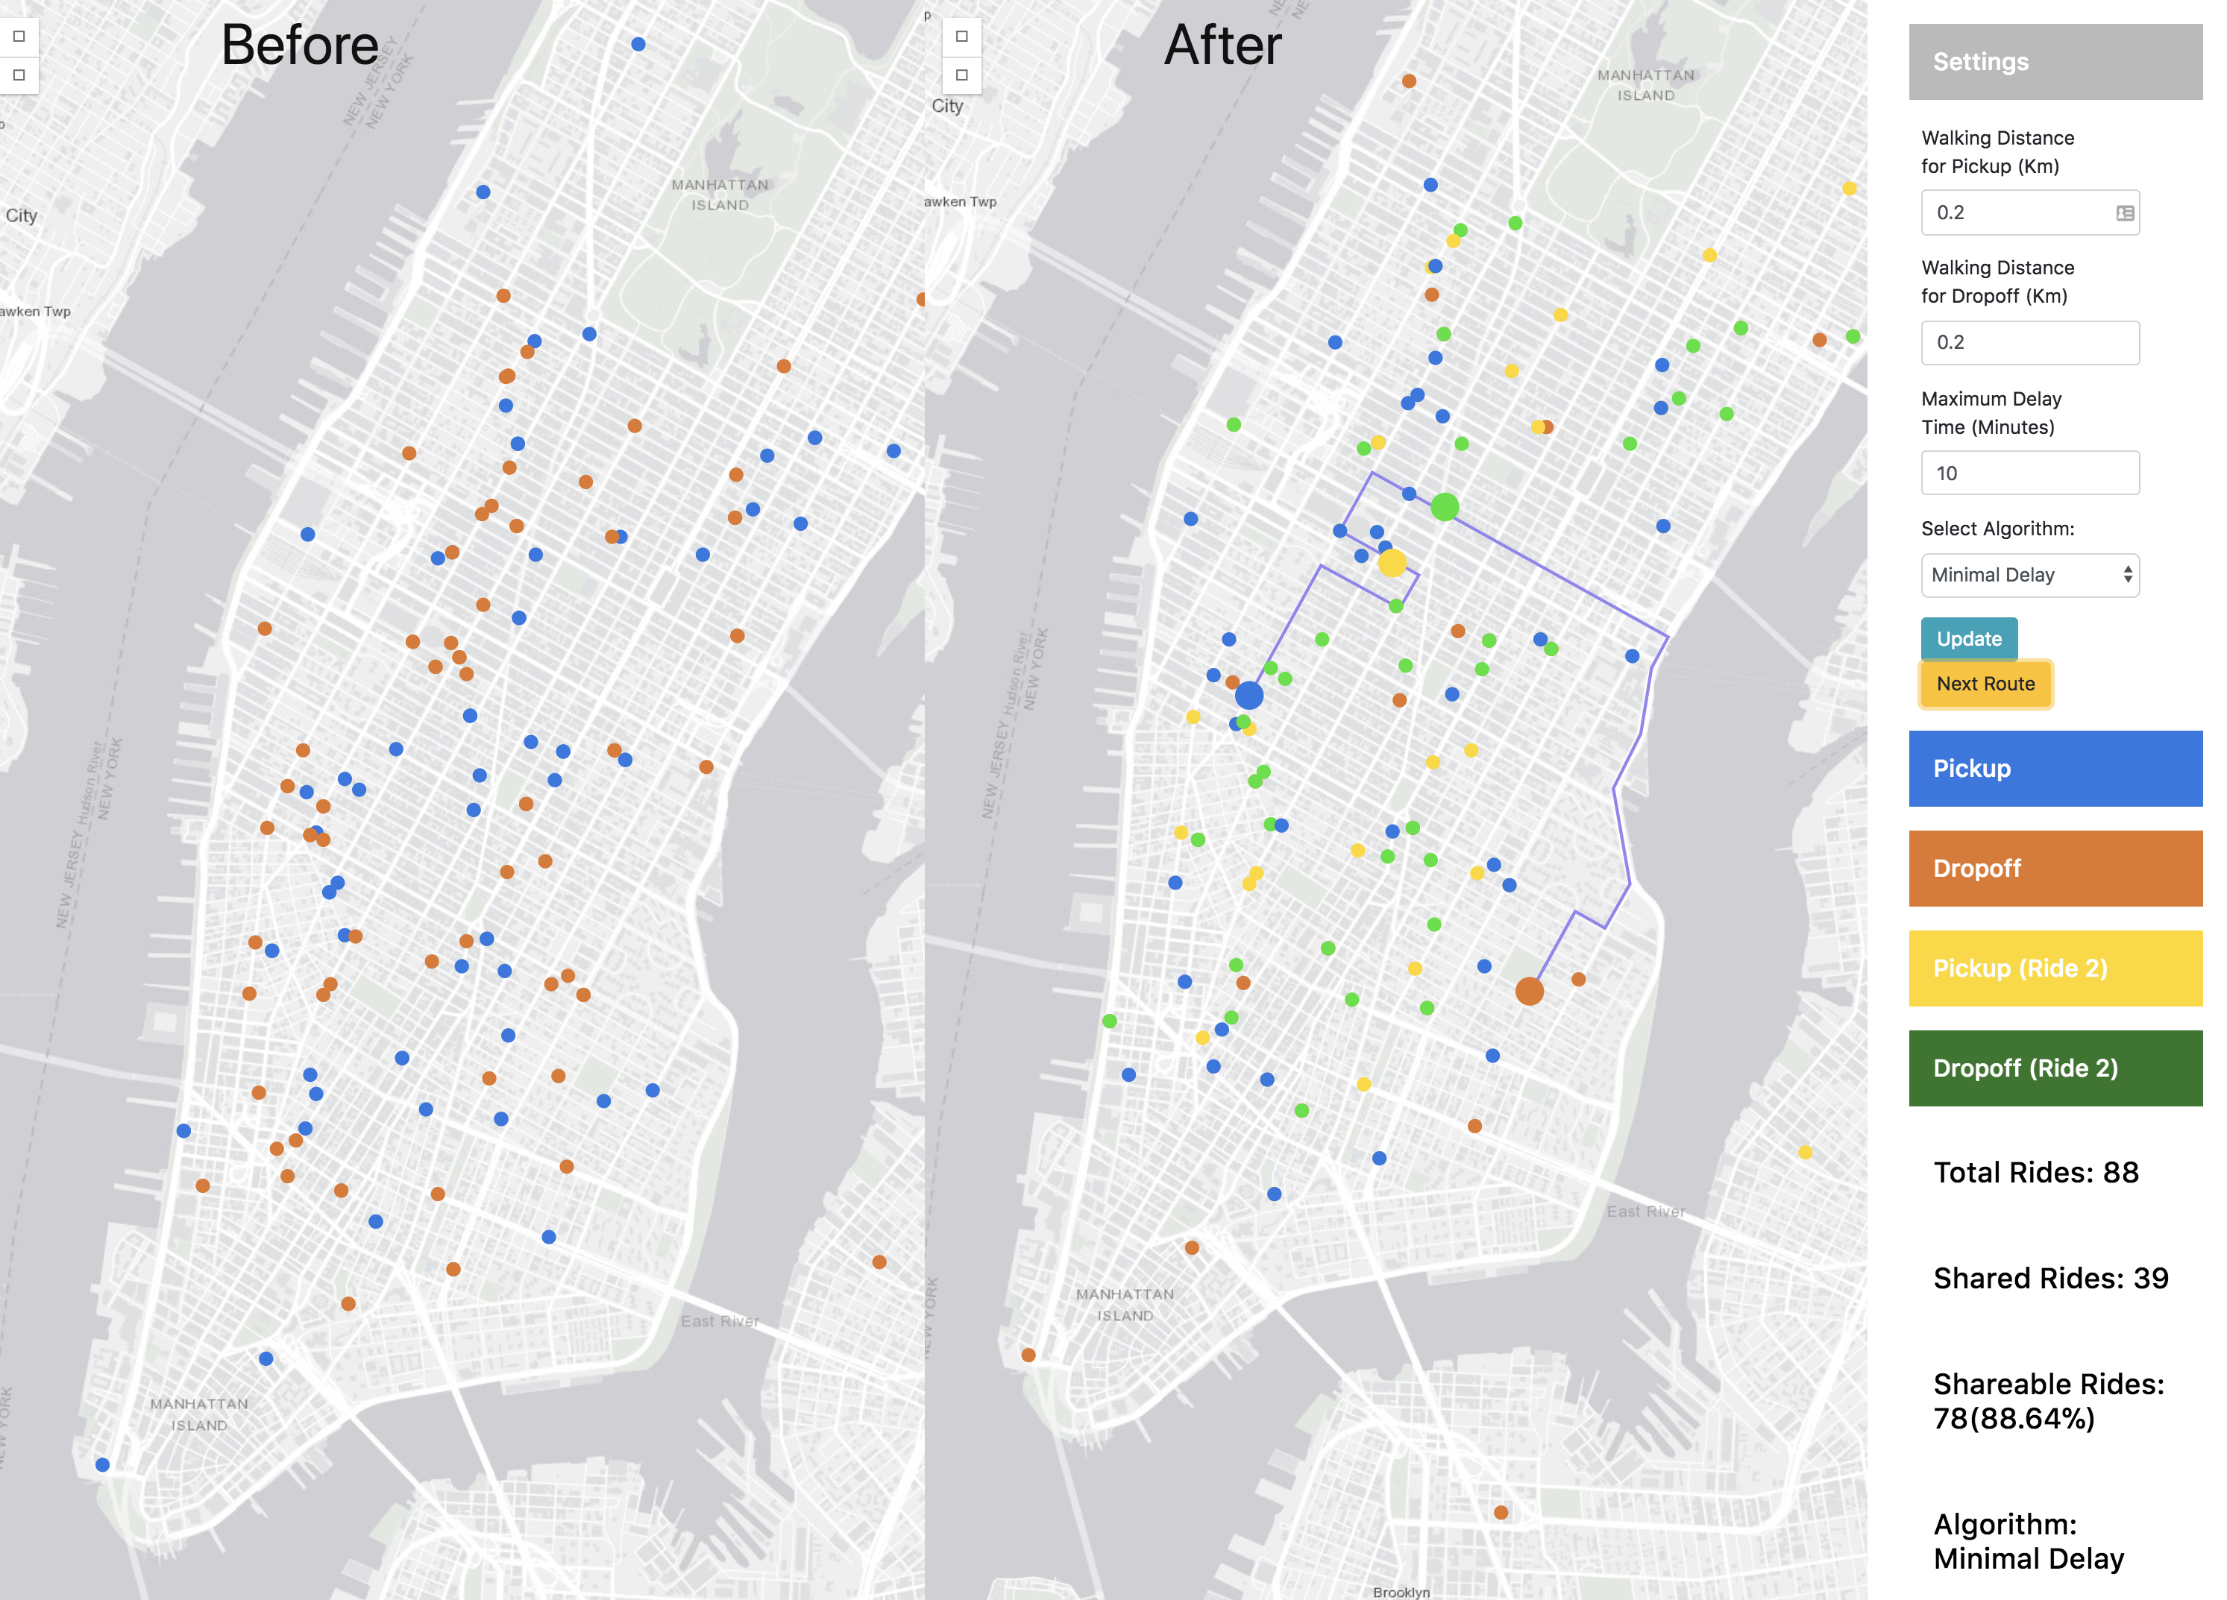
Minimal Delay Algorithm- Results
Here we can see the dynamic dispatch of a journey, with the route being changed to go through the second journeys pickup point (yellow)
This is a good route however some routes are still sub optimal
On data sets tested > 70% of rides are shared

Slide 11
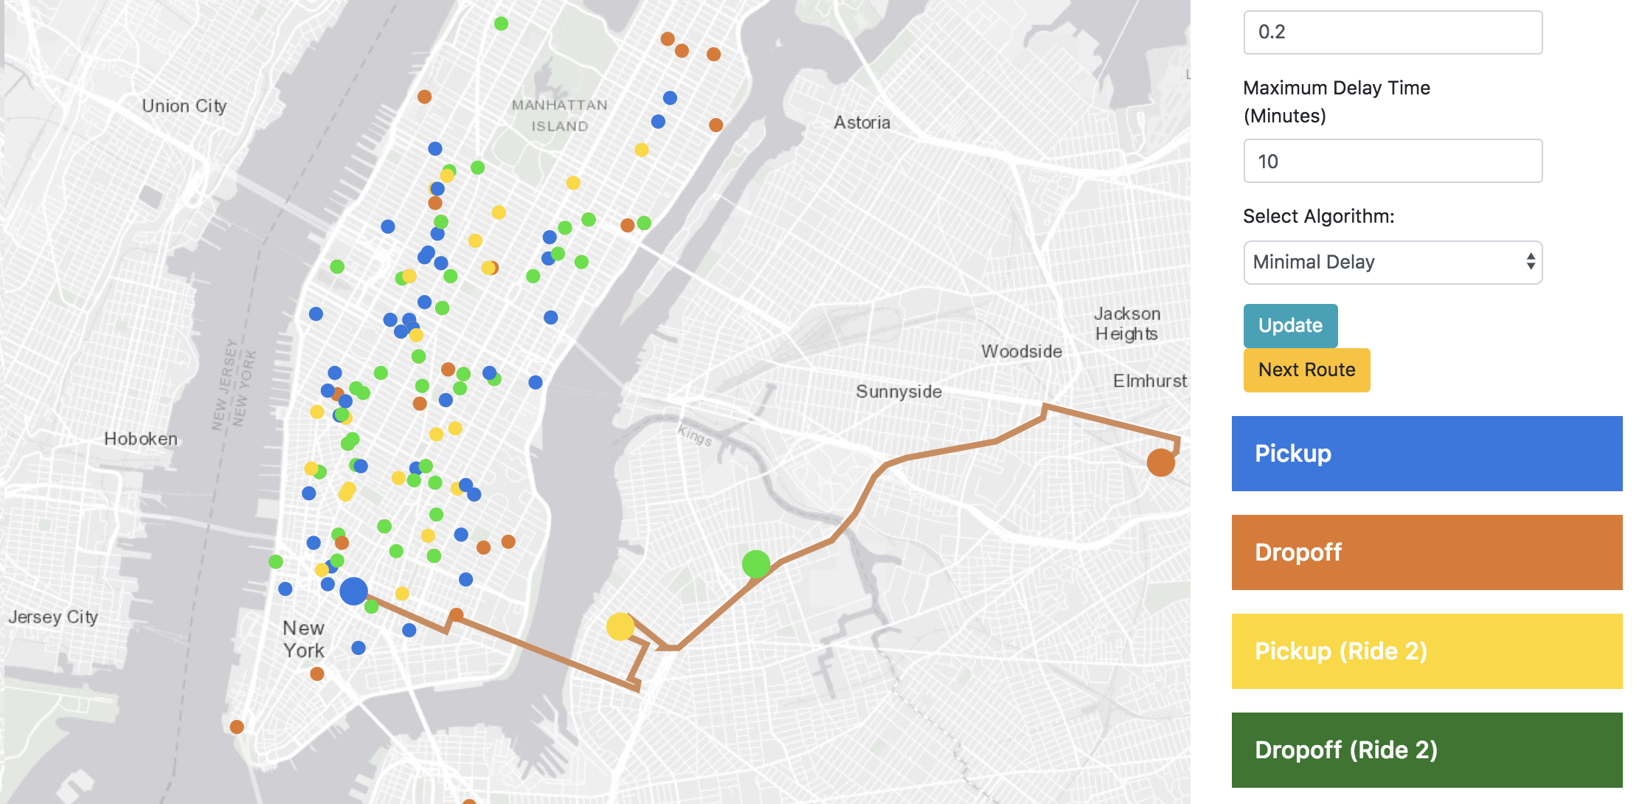

Slide 12
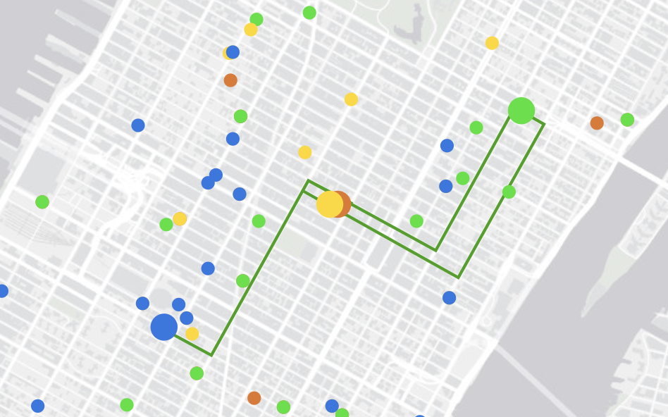
Constraints are still satisfied but not optimally.
This a minimization and matching problem – order of consideration changes results.
Could go from yellow to orange and drop off but instead visits green (second journeys dropoff)

Slide 13
Technology Used
Python
With associated data handling libraries
Pandas, Numpy, geopy, DBSCAN, Flask
Bash command line tools
Sed, AWK, head, tail
ArcGIS JS + JQuery
Allows 2d and 3d geo-data visualization

Slide 14
OSRM – Routing Engine
Used for Minimal Delay algorithm
Long build time using open street map data for New York hence only finished compilation on Sunday
Open Street Map Data is free to download.
Most cities have individual exports for faster reading into OSRM (when compared to an entire countries road network)
Free, Open Source, Fast!
HTTP API + Python Bindings
Use this for high volume of requests instead of Google routing services unless you require real time congestion avoidance.
Also has a C library.

Slide 15
Algorithm
Groups taxi trips into N minute intervals
Where N minutes is the maximum waiting time

Slide 16
Future Work – Shareable Ride Analysis
Determine if certain destinations have a high proportion of shareable rides.
The types of these destinations can be determined using the reverse geocode and Place API from Google
Compare performance of algorithms for different datasets
Cluster data before and after sharing to determine whether congestion is eased up
Similar centroids but reduced cluster size would show reduced congestion
Visualizer shows heavy reduction of congestion in popular areas.
Optimize for other metrics such as cost
Investigate human factors which determine shareable rides
Look for existing studies
Approach as a Graph Theory based problem

Slide 17
Future Work – Improved Algorithms
Implement algorithm from “Quantifying the benefits of vehicle pooling with shareability networks” and attempt to repeat their finding that 95% of rides can be shared.
Develop an algorithm that uses ’pick up on the way’ as opposed to simply meeting at pickup location
Is passengers pickup location on the taxis current route
Drop off can also be done
This is how real world ride sharing platforms such as Uber work.
Recompile OSRM to allow for larger distance matrices
Current limit means journeys have to be grouped before they are shared, which means we lose potential rides through interclass overlap.

